Slide 1


Job Salaries Analysis Project 1
Ana Brissa Miranda Espinoza
Ana Sofia Garrido
Santiago Ayala

Slide 2


Objectives
Get the average salary according to the experience level:
Count how many employees are by country.
With the average, compare by employment type
With the average compare by remote ratio.
Get the average salary according to the employee residence
With the average, compare by remote ratio.
Get the salary by job title and compare with the employee's residence.
Get the historical change by experience level
Notes:
The remote ratio is divided by 3 hours. 0 (No remorte work), 50 (Partial remote work/Hybrid) or 100 (Fully remote (More than 80%)

Slide 3
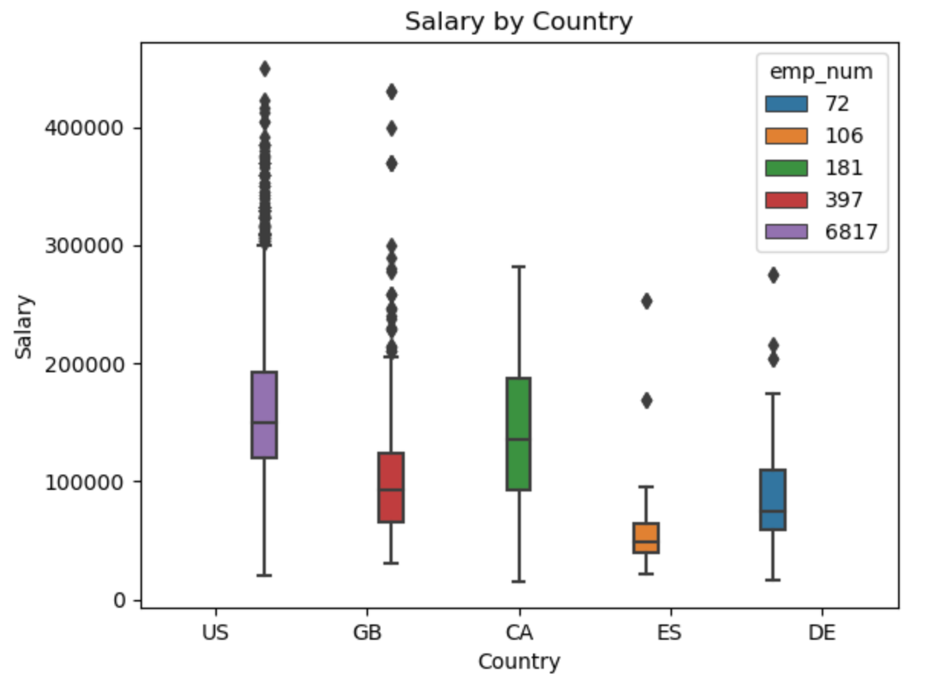
Salary by Country
The offer of Data Analyst employees is higher in US than the rest of the 4 countries in the top 5 countries.
The US has a bigger amount of outliners, followed by British and Denmark.
US and Canada have the same average salary, however, Canada doesn't have outliners, seems that the salary is standardized.
Spain has the lower salaries unless has more offers of employment

Slide 4
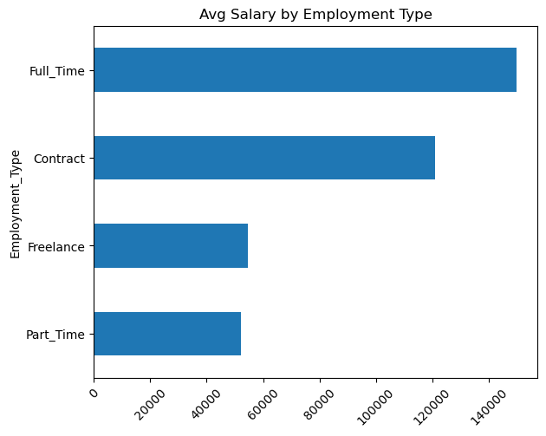
Average salary of the employment type
Here we can see that working on a full time has a better salary than the other ones with an average of $150k next is contract with $120k then Freelance with $54k and last there is part time with $52k.
We have to say that there is more data with the full time than the others so this may not be that exact
Notes:
I have to say that there is more data with the full time data than the others so this data may not be that exact

Slide 5
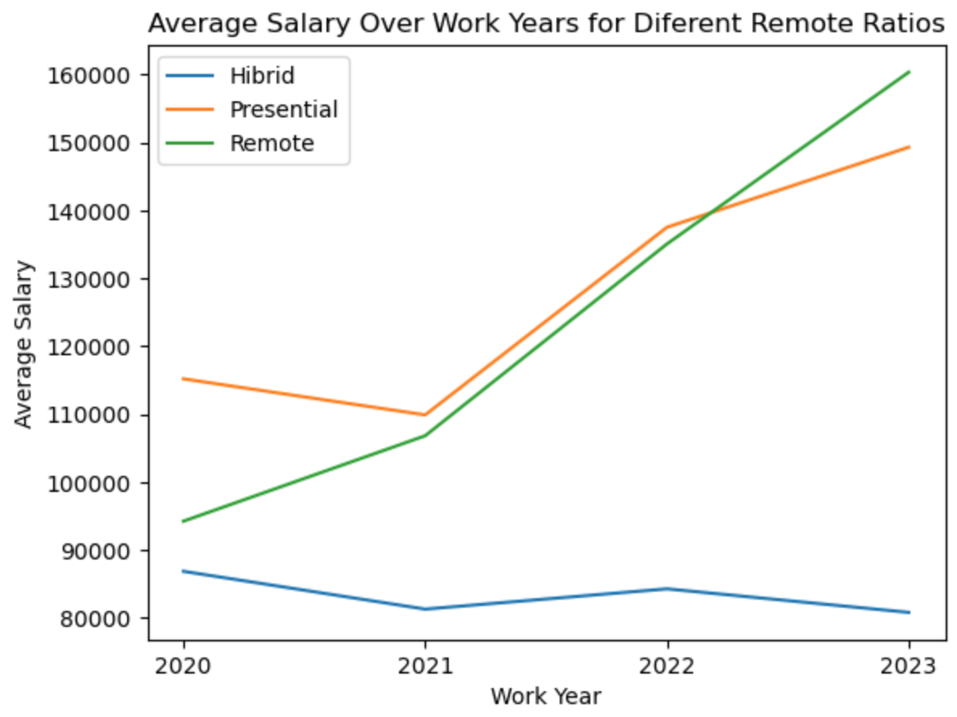
Average Salary over years
The average salary has been increase over the years, except for the hybrid model.
After the pandemic, the remote and presential model has been increase dramatically.
The remote model has been constantly increasing higher than Hibrid and presential models

Slide 6
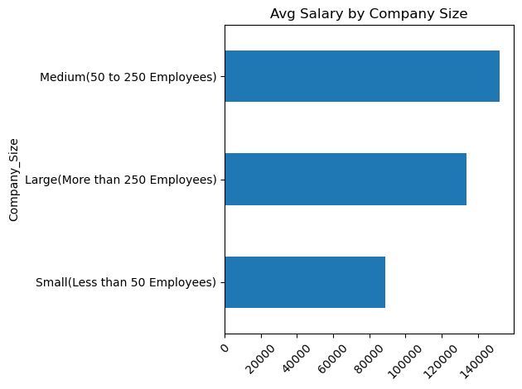
Average salary according to Company Size
The salary of a medium company as an average has a total of $152k next there is the large companies with $133k and for the small companies they are with $88k.
There is a large gap between a medium company and a small company by a bit more of a 40%. This makes sense because of the amount of employees that work for the companies.
What was weird was that the large company is below of the medium company even though there is majority of employees .

Slide 7
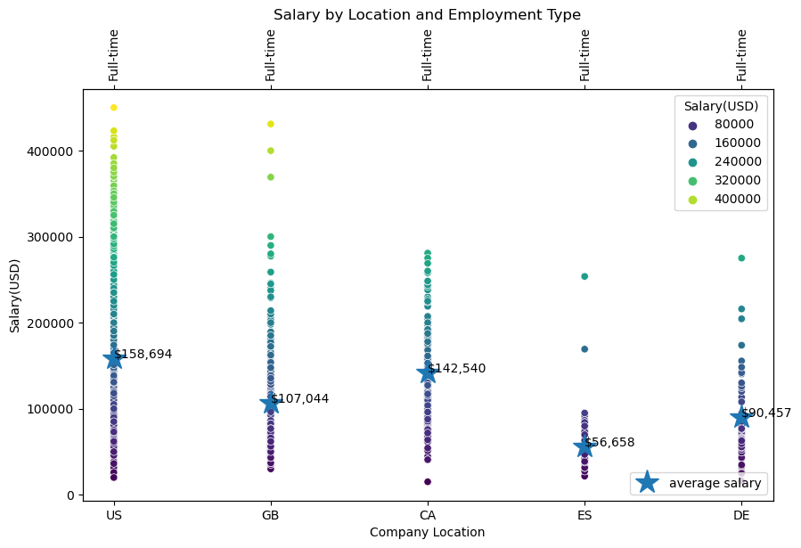
Average salary by location and employment type

Slide 8
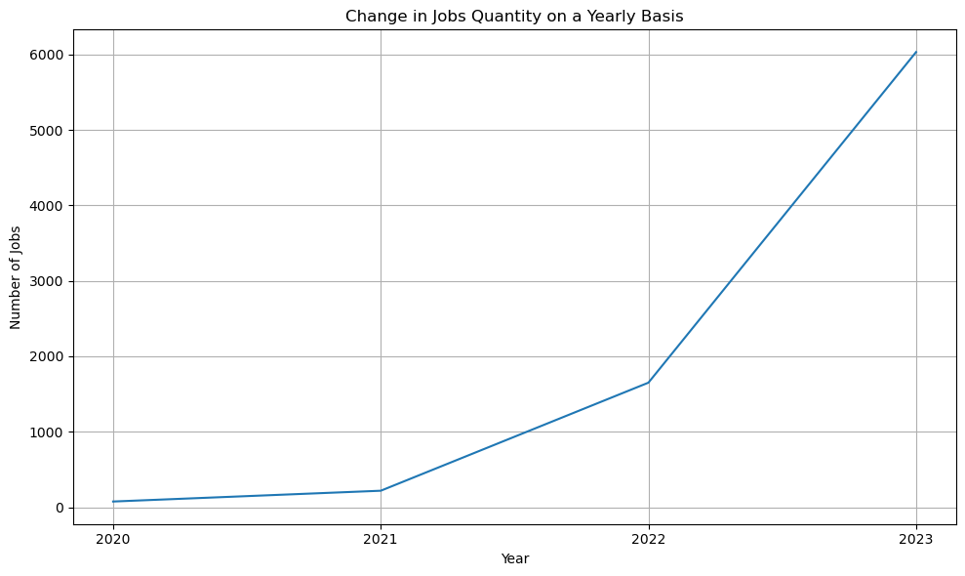
Jobs per year

